Slide 1
Lecture 7: Knowledge Base Construction: From dark data to insights

Slide 2
Today’s Lecture
Dark data
Knowledge base construction (KBC)
Incremental KBC

Slide 3
1. Dark data
Section 1

Slide 4

Structure in data is great…
Section 1

Slide 5
Structure in data is great…
Section 1
because computers can understand it

Slide 6
Structure in data is great…
Section 1
because computers can understand it and we can analyze it, obtain insights from it and make better decisions

Slide 7

Sunny days are over
Section 1

Slide 8
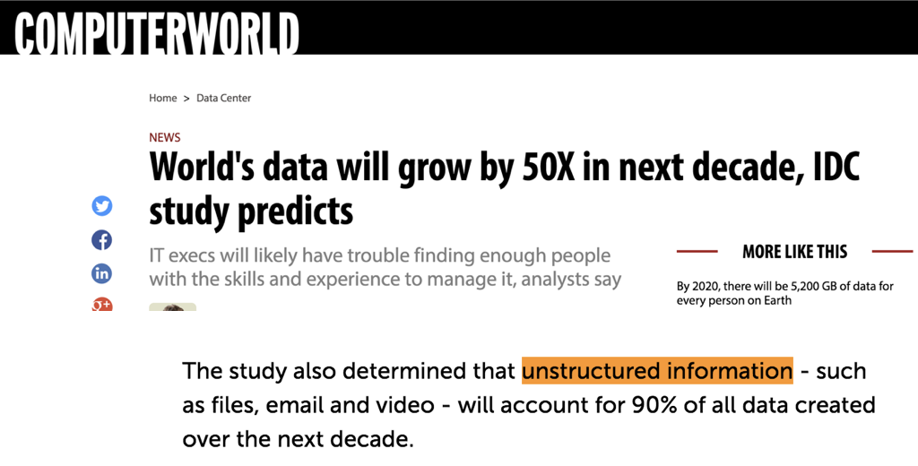
Sunny days are over
Section 1

Slide 9
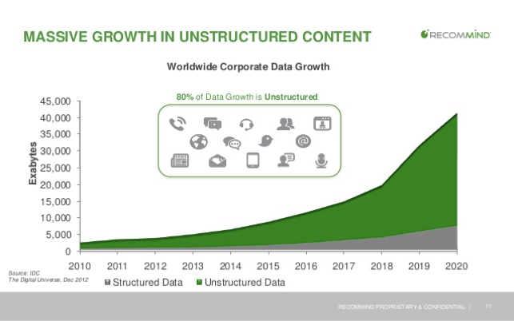
Sunny days are over
Section 1

Slide 10
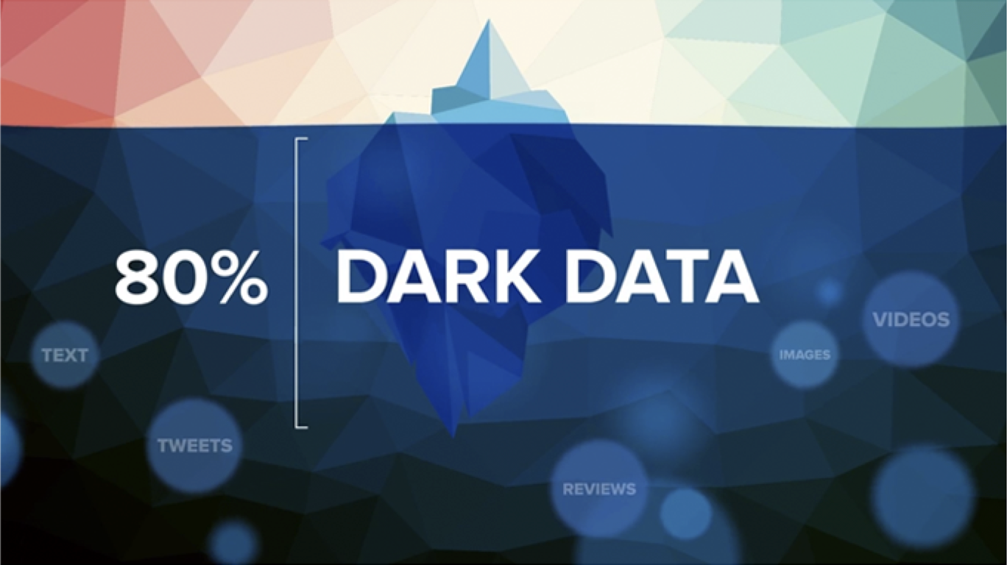
Section 1

Slide 11
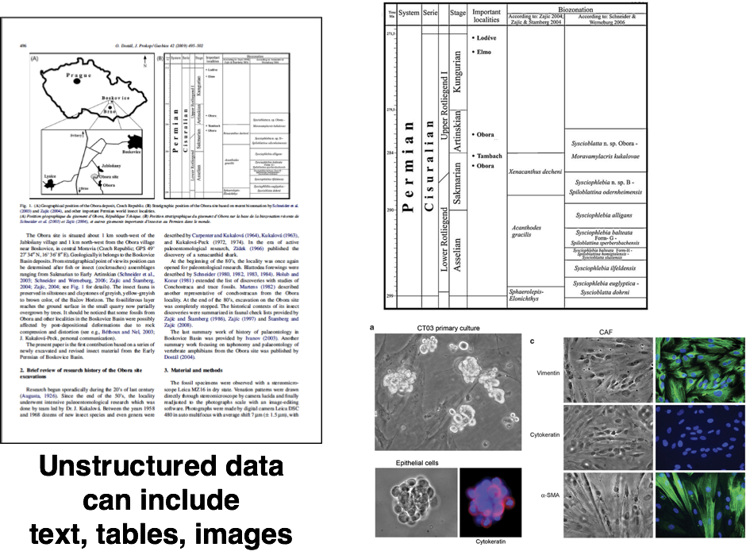
Section 1

Slide 12
2. Knowledge base construction (KBC)
Section 2

Slide 13

Personalized medicine
Section 2

Slide 14
Personalized medicine
Section 2

Slide 15
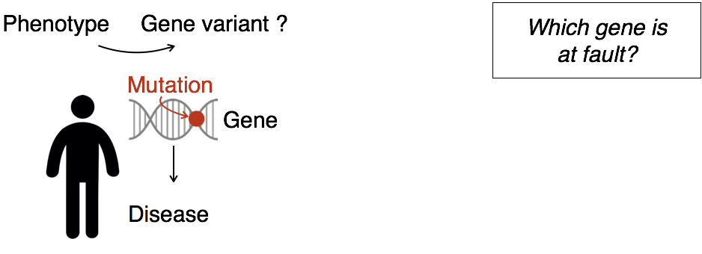
Personalized medicine
Section 2

Slide 16
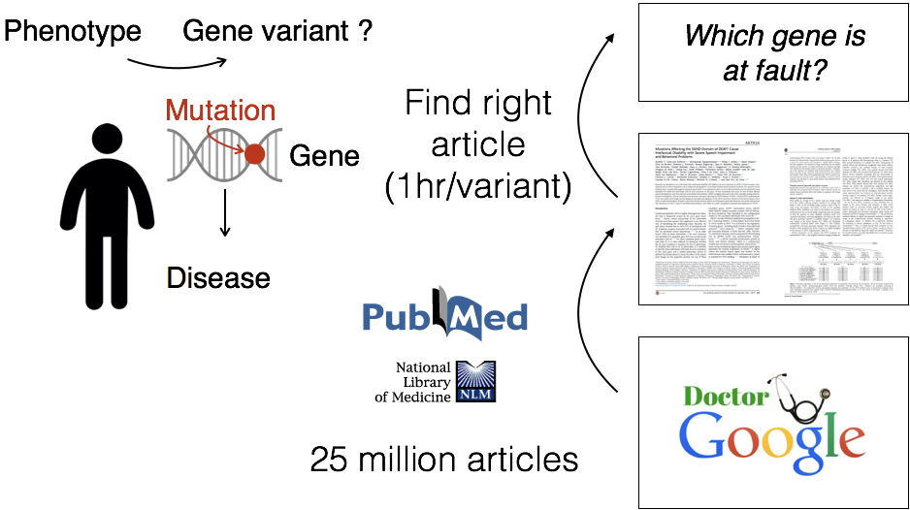
Personalized medicine
Section 2

Slide 17
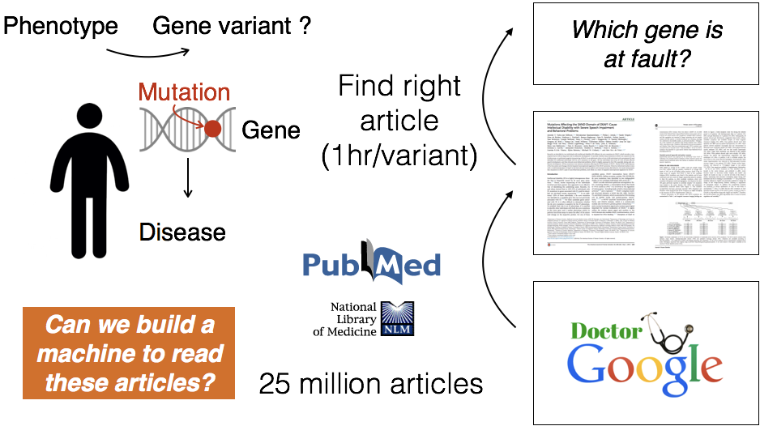
Personalized medicine
Section 2

Slide 18
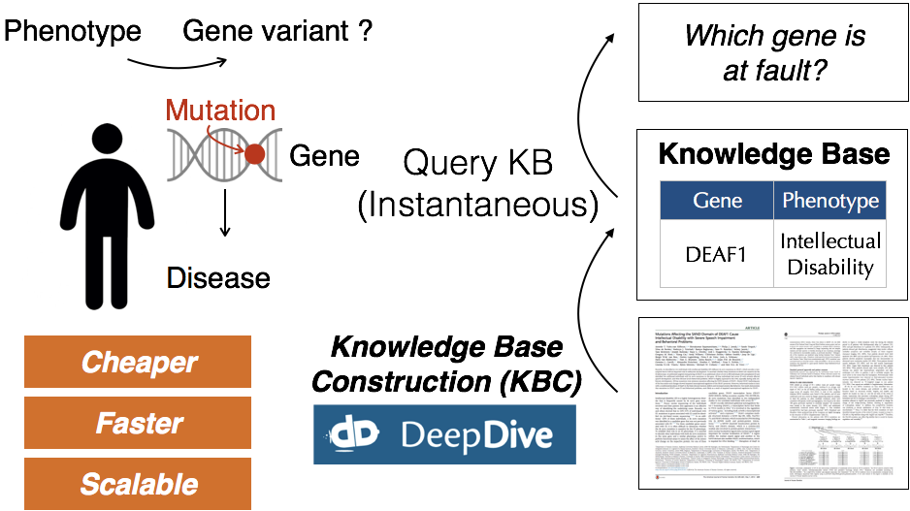
Personalized medicine
Section 2

Slide 19
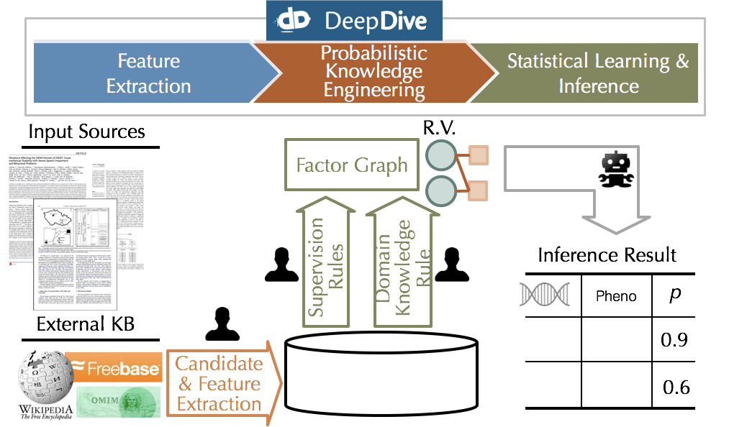
KBC Workflow
Section 2

Slide 20
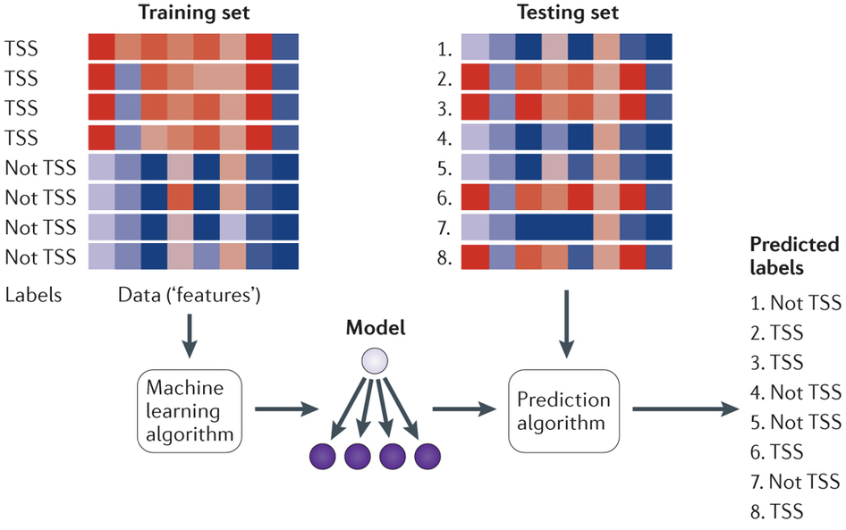
DeepDive is a trained system
Section 2

Slide 21
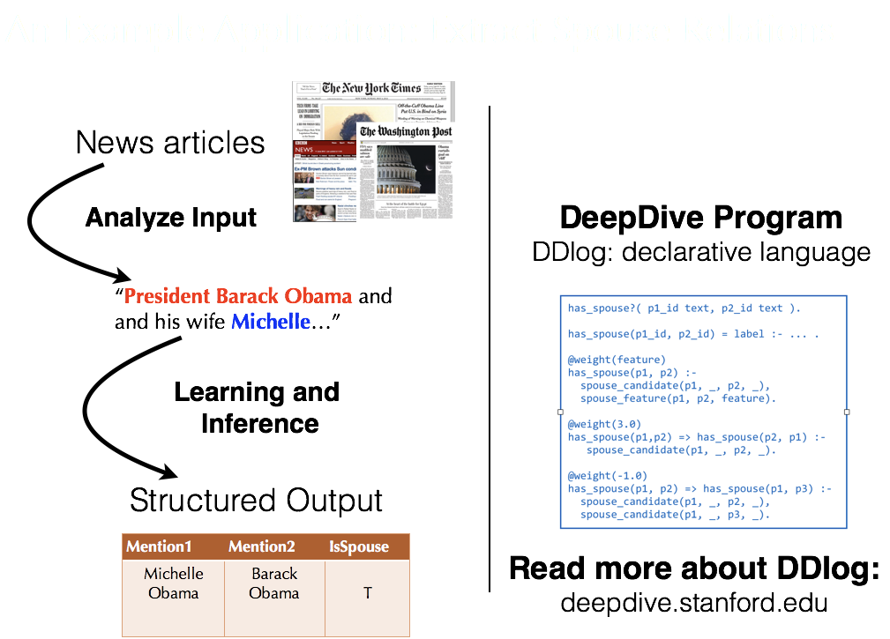
Section 2

Slide 22
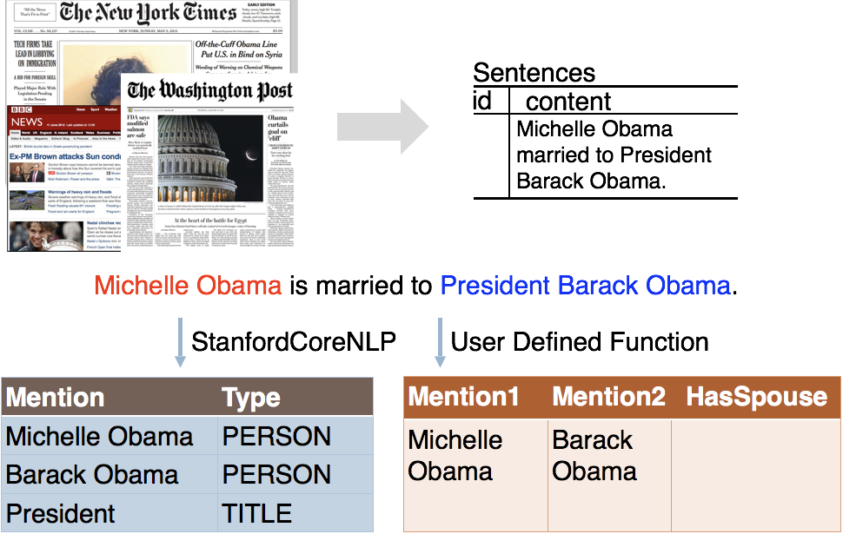
Candidate extraction
Section 2

Slide 23
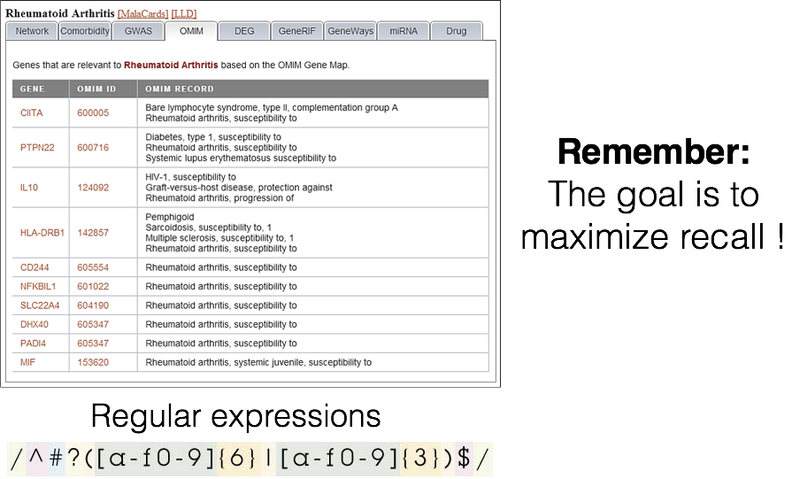
Candidate extraction++
Section 2

Slide 24
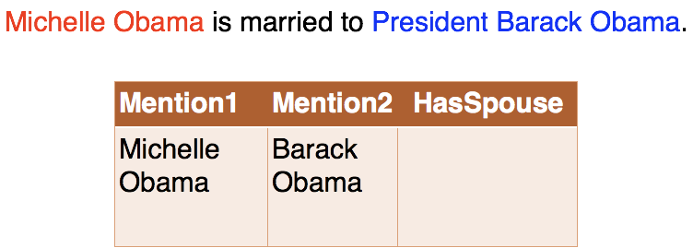
Feature extraction
Section 2

Slide 25
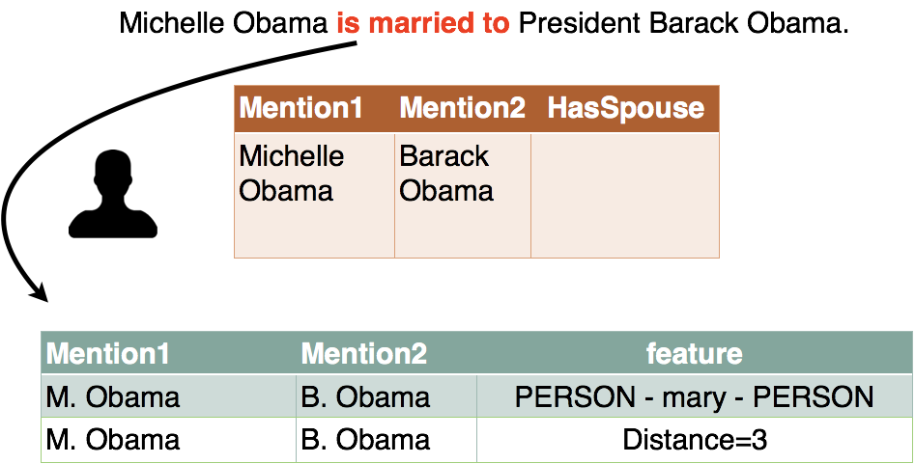
Feature extraction
Section 2

Slide 26
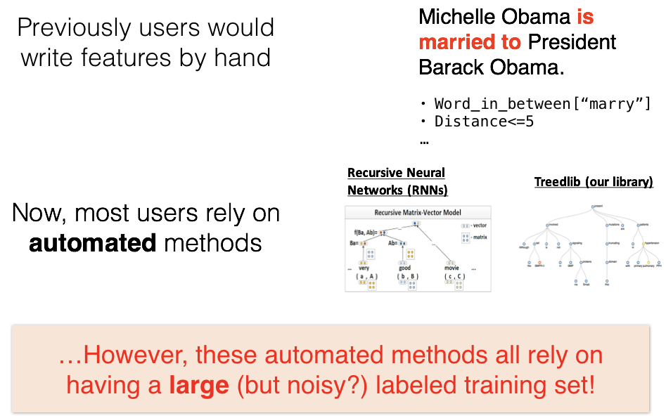
Obviate feature engineering
Section 2

Slide 27
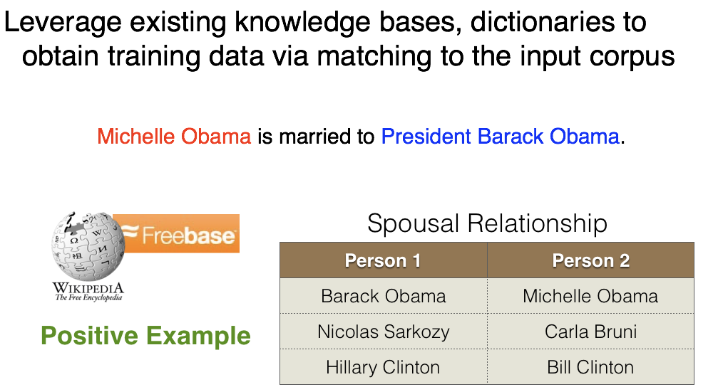
Distant supervision
Section 2

Slide 28
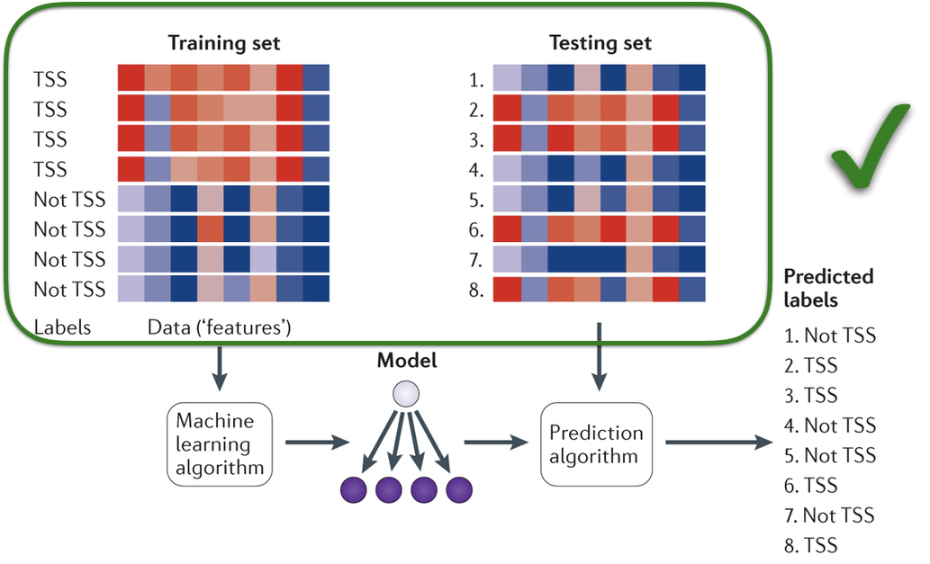
DeepDive is a trained system
Section 2

Slide 29
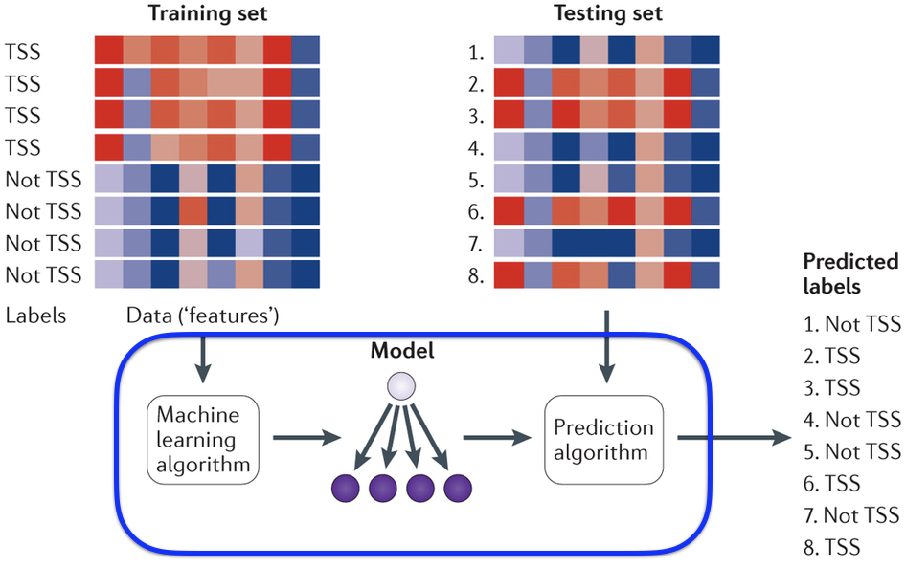
DeepDive is a trained system
Section 2

Slide 30
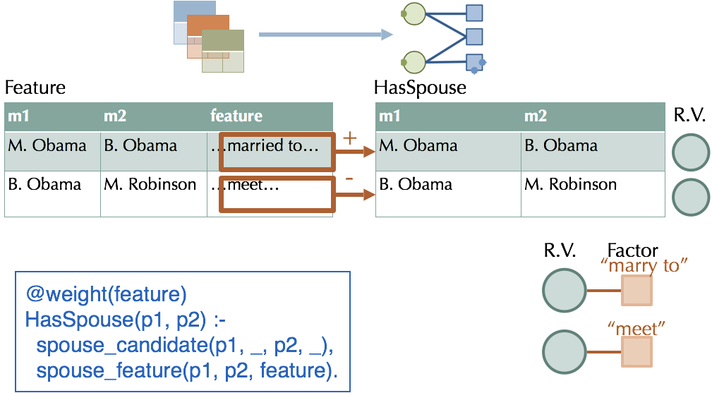
Probabilistic knowledge engineering
Section 2

Slide 31
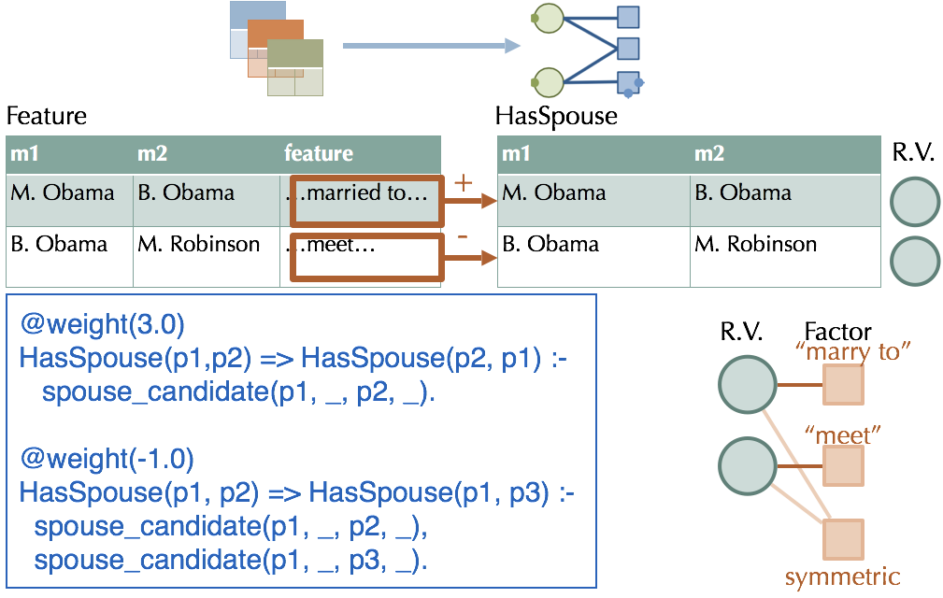
Probabilistic knowledge engineering
Section 2

Slide 32
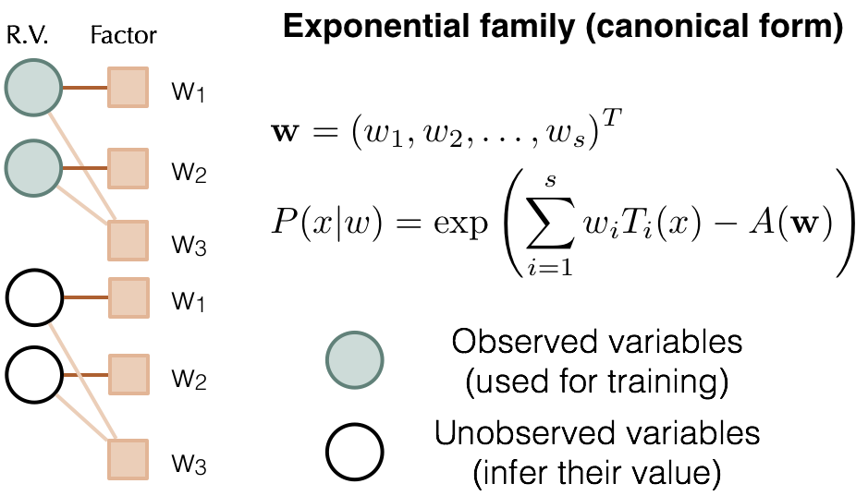
Factor graphs
Section 2

Slide 33
Probabilistic Inference with Gibbs Sampling
Section 2

Slide 34
3. Incremental KBC
Section 3

Slide 35
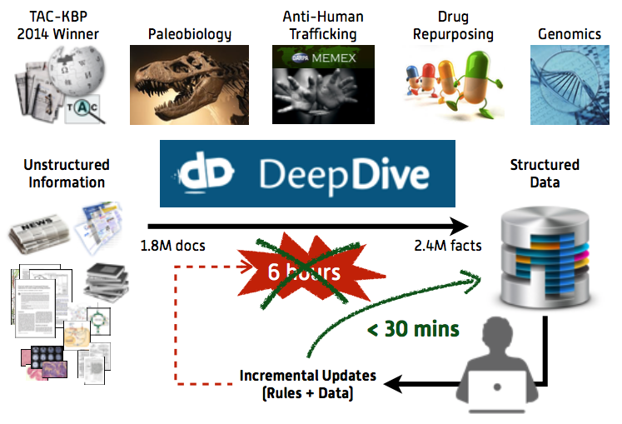
Reruns take time
Section 3

Slide 36
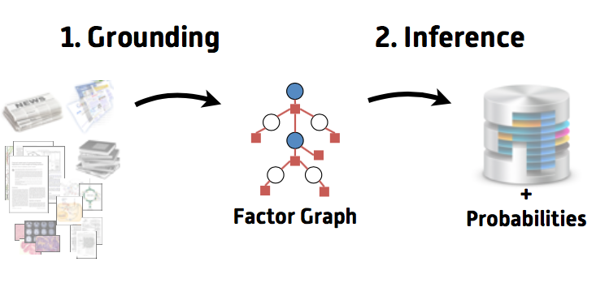
Section 3

Slide 37
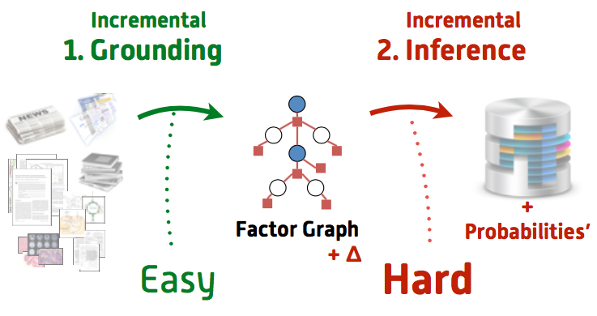
Section 3

Slide 38
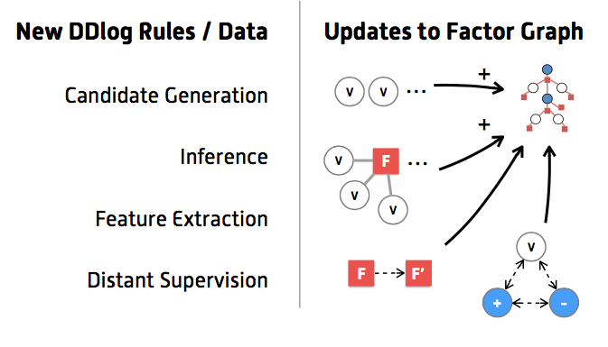
Types of updates
Section 3

Slide 39
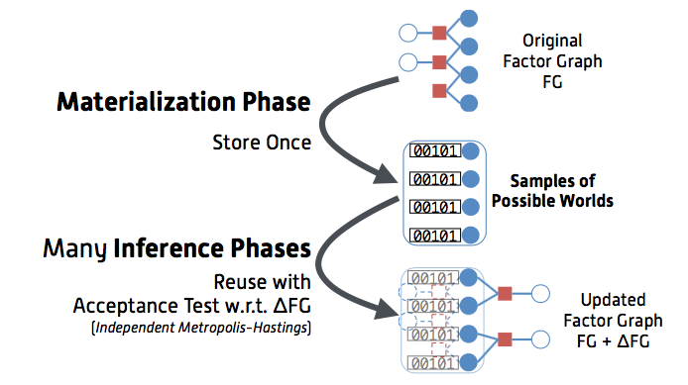
Incremental Inference: Sampling
Section 3

Slide 40
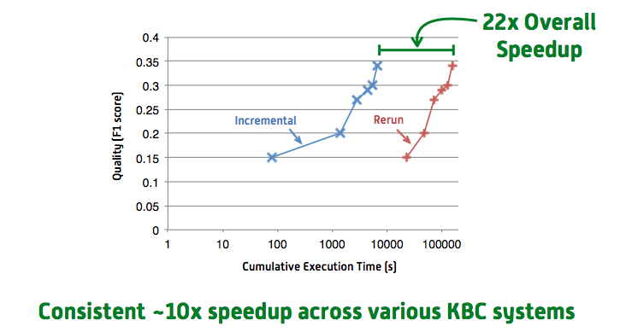
Quality over time
Section 3

